Slide 1
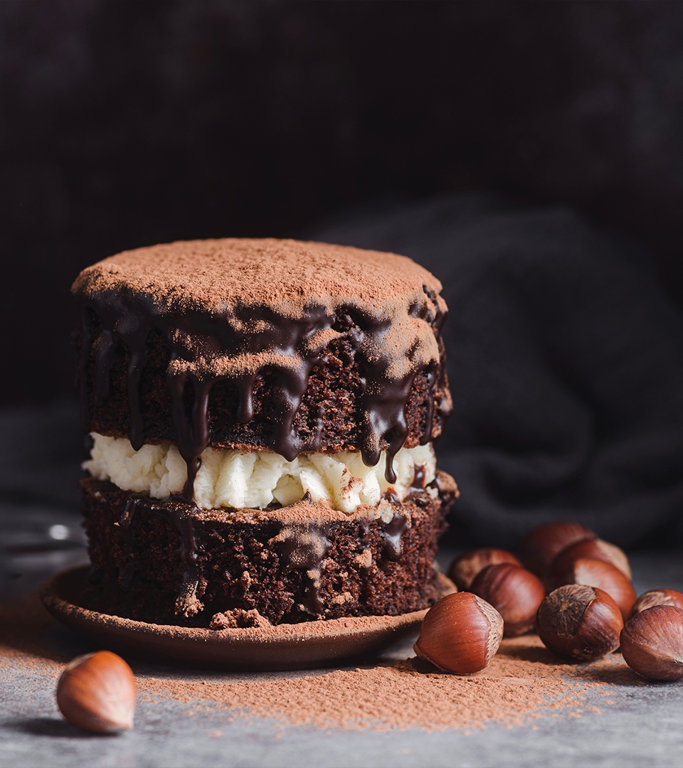
Dig-In!
Understanding How Users Interact with Food and Recipe Content
By Jonathan Ayala
Notes:
Hello there!
My name is Jonathan Ayala, and I’d like to thank you for reading through this presentation! Today we’ll be looking at a week’s worth of pageview data for Food and Recipe content on PureWow and uncovering data-driven insights and recommendations on how to optimize user engagement for the Marketing team.

Slide 2
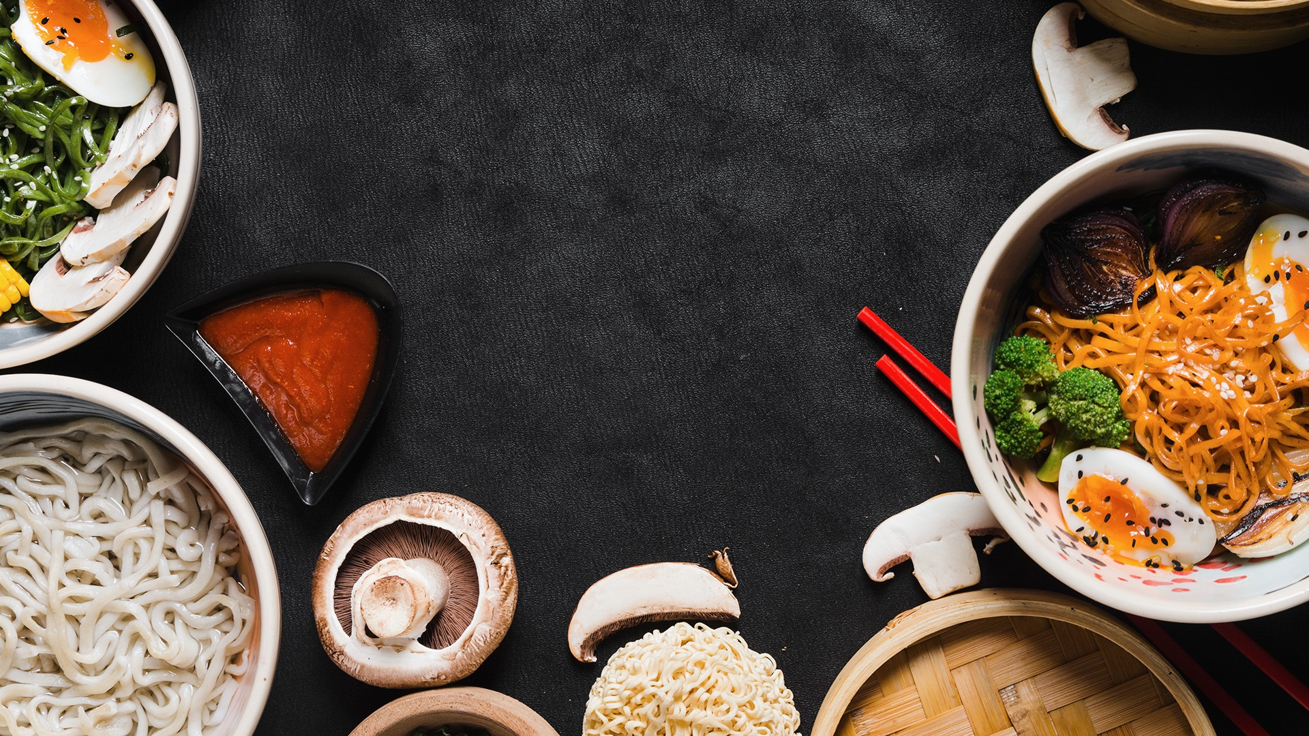
BACKGROUND
Exploring Food and Recipe content data for the week of 9/1/20 - 9/8/20.
Objective
Generating data-driven insights and recommendations to capitalize on content and foster understanding of our users.
Note
A single user generated a view on 9/8/20 and was excluded from the analyses. 9/8 appears to have been the date the data was extracted, so their User ID does not appear in the subscribers table.
Notes:
Here’s a breakdown of the presentation, for your reference!

Slide 3
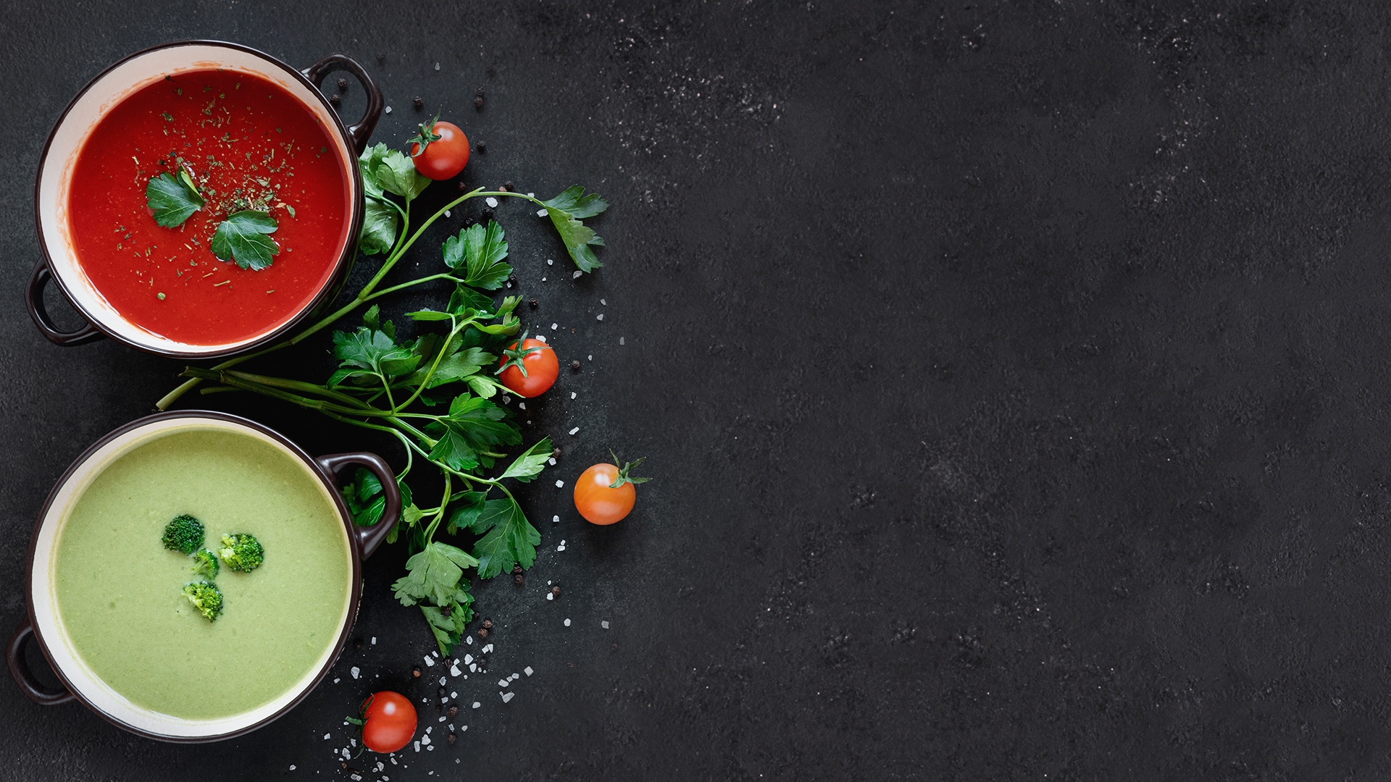
01.
Exploring the Views
Food and Recipe content for 9/1/2020 – 9/8/2020

Slide 4
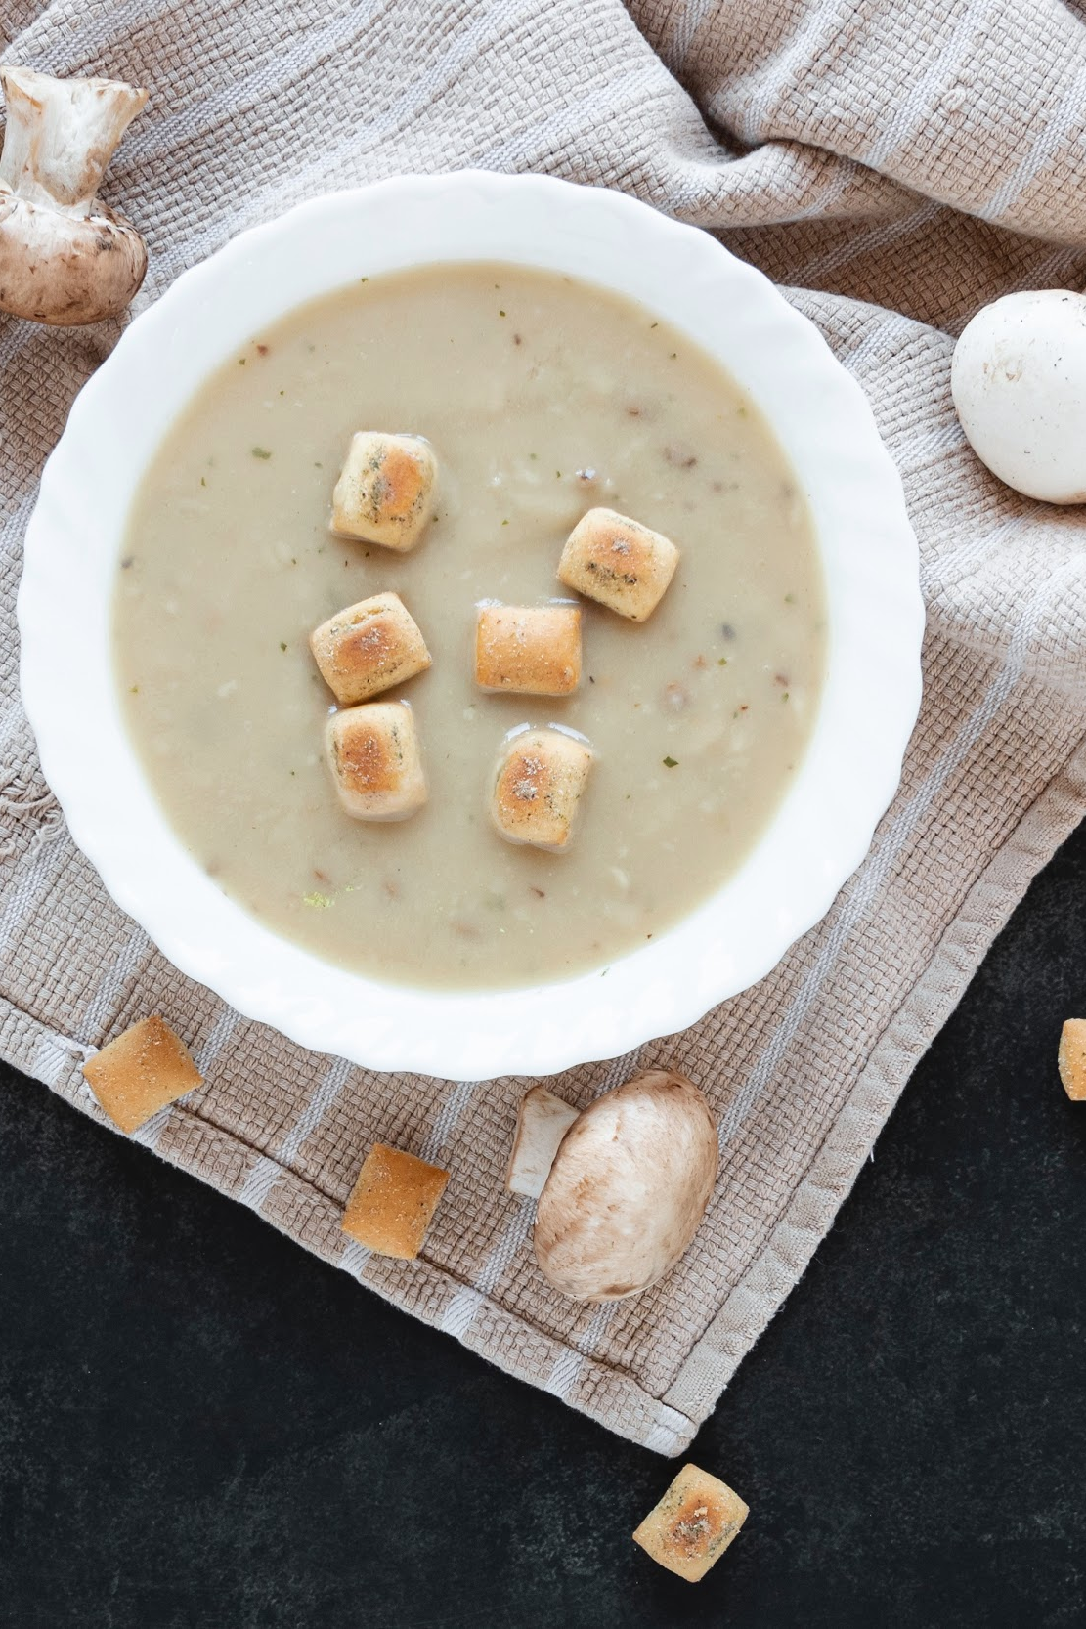
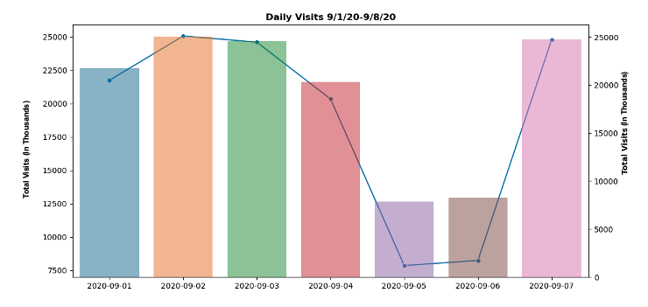
Breaking Down the Week
01.
132,662 total visits, with 18,952 daily views on average.
02.
Thursday (9/2), Friday (9/3), and Labor Day (9/7) were the most viewed days of the week, accounting for 74,460 (or 56%) of total views.
Notes:
Users are visiting 132,662 times a week, or 18,952 times a day, excluding the final date (9/1/20) with a single view (as the outlier drastically alters the average). Thursday (9/2), Friday (9/3), and Tuesday (9/7) were the most viewed days of the week, accounting for 74,460 (or 56%) of total views.

Slide 5

02.
Analyzing Traction
Viewership by Campaign and Format

Slide 6

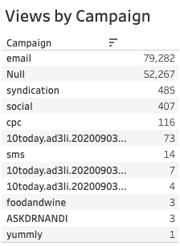
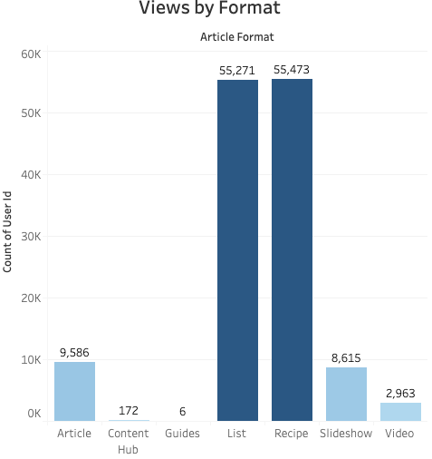
Exploring Content Traction
“Email” campaign accounts for 60% of views.
39% of views had no campaign listed; considered “Organic” (users landed on webpage on their own).
Recipe and List are preferred content formats for being concise; require less effort (Slideshow clicks) and focus (Video).
Seasonally relevant articles (like “45 Easy Labor Day Recipes to Celebrate the End of Summer”) excel at drawing attention.
Notes:
Apart from PW as a page_referrer, there are plenty of views being generated from referrers like Google/Gmail, and Pinterest (seeing as quite a few recipes originated there!). Our email campaign was by far the most successful. It accounts for 79,282, or nearly 60% of traffic for the week.
39% of all views for the week were generated where no campaign was listed, with the page_referrer primarily being the PW site. This could mean that it was "organic" traffic (users landed on the webpage on their own). So, it's good that one of the highest segments of views are devoted readers!
As far as food and recipes are concerned, users prefer viewing Recipes and Lists the most, as it's straight to the point as to what ingredients are needed, and what they need to do to prepare the meal. Other formats are more involved, requiring more clicks (ie Slideshows), or more active attention (ie Video and Articles).
The top trending pages all feel new and *relevant*. With Labor Day being 9/7/2020, it's no wonder the highest webpage viewed (by a large margin) was "45 Easy Labor Day Recipes to Celebrate the End of Summer?" We can see that other articles that had traction at this time mentioned Summer (and related foods like Ice Cream), Labor Day, Fall, and September-specific updates (ie What's New at Trader Joe's: September 2020).
There's room to grow when it comes to Social campaigns.

Slide 7

03. Optimizing Emails

Slide 8
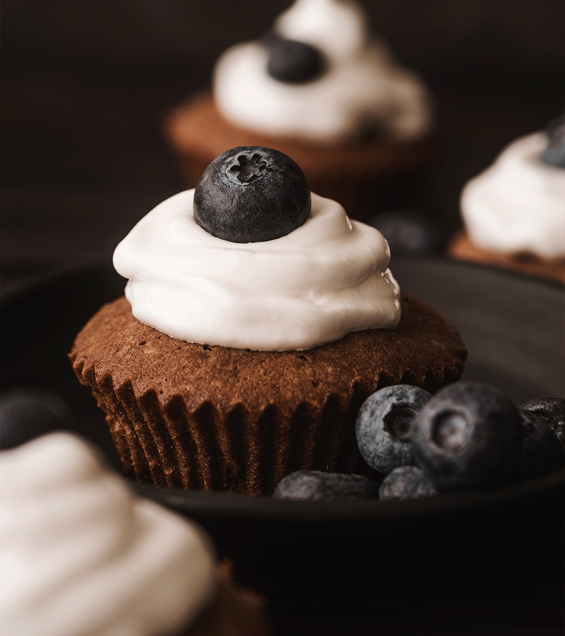
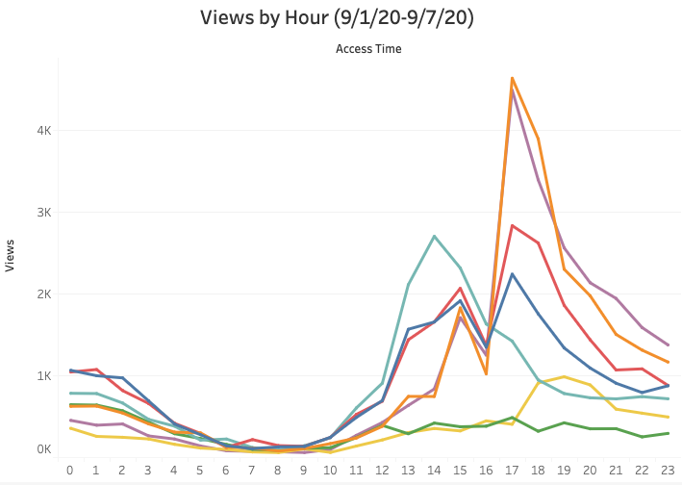
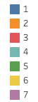
4 AM to 9 AM have low views; 12 PM to 3 PM and 4 PM to 6 PM best times for email marketing.
Improve weekend views via lazy Sunday/brunch and weekly meal prep recipes.
Note: hours listed in military time with each line representing a day of the week
Notes:
The hours of highest traffic during the week lie between noon and 3 PM (common lunch hours), and 4 PM to 6 PM before steadily declining through the evening. Conversely, the lowest amount of traffic on any given day are between the hours of 4 AM and 9 AM. These hours would be the best in which to send out emails.
We can improve early morning views, especially for those who browse during their commute. Additionally, it's worth noting that Sunday and Monday receive the least amount of traffic. Generally, weekends adhere less to these trends. People have much more time and options in terms of the media they choose to consume. We can become more relevant here (stay-at-home brunch recipes, lazy Sunday recipes, best foods for starting your week off right, etc).

Slide 9
Recommendations to Marketing
Seasonality is key to content relevancy.
Email marketing is especially effective during lunch and post-work/dinner hours but lacking in the early morning. Email also generates the most views.
The content formats with the highest traction are Recipe and List. The more direct this content is (the more time it saves our users), the better it will perform.
Notes:
Recommendations:
The week in data revealed that seasonality and new articles are key to feeling relevant for our users. We saw this impact through the amount of Summer, Fall, and Labor Day content receiving the top spots for viewership. The highest trending content was also published during this year's Summer season. Further, as far as food and recipe content is concerned, Recipe and List formats account for 83% of all views for this week (41.8% and 41.6%, respectively). This means that users want to get right to the point in knowing what they need to prepare and ultimately cook/bake their food. The less attention they have to pay (ie clicking with Slideshows and actively watching Video), the more engaged they will be.
Early morning hours (between 4AM-9AM) aren't the best times to market food and recipe content, but gain much more traction during lunch (noon - 3 PM) and post-work/dinner hours (4PM - 6PM). Sunday and Monday were the lowest points, but could be capitalized on with content like Sunday brunch recipes and simple meal prep recipes for the week.
Email was the most impactful campaign for the week, followed by Organic. Social should be generating more, but it's a positive sign that our efforts via Google/Gmail and Pinterest are working.

Slide 10
Suggestion/Next Steps
Further segment the audience using demographic info (age, location, device, browser, search query, session duration).
In this way, market the right content to the right users.
Analyze social channel data, there’s so much opportunity for growth!
Notes:
Suggestion/Next Steps:
In order to further segment and understand this audience, we should have a lot more demographic information. Age, location, desktop or mobile, session duration, search query, which browser they used to access the site, etc. Each of these can be used to help us better understand user tastes on an individual basis, so we can most effectively market the *right* content to them.
I'd also love to analyze social data generated from Twitter, as Social could potentially make a higher impact on usage and engagement of the product. Natural language processing and sentiment analysis may be long-term goals!

Slide 11
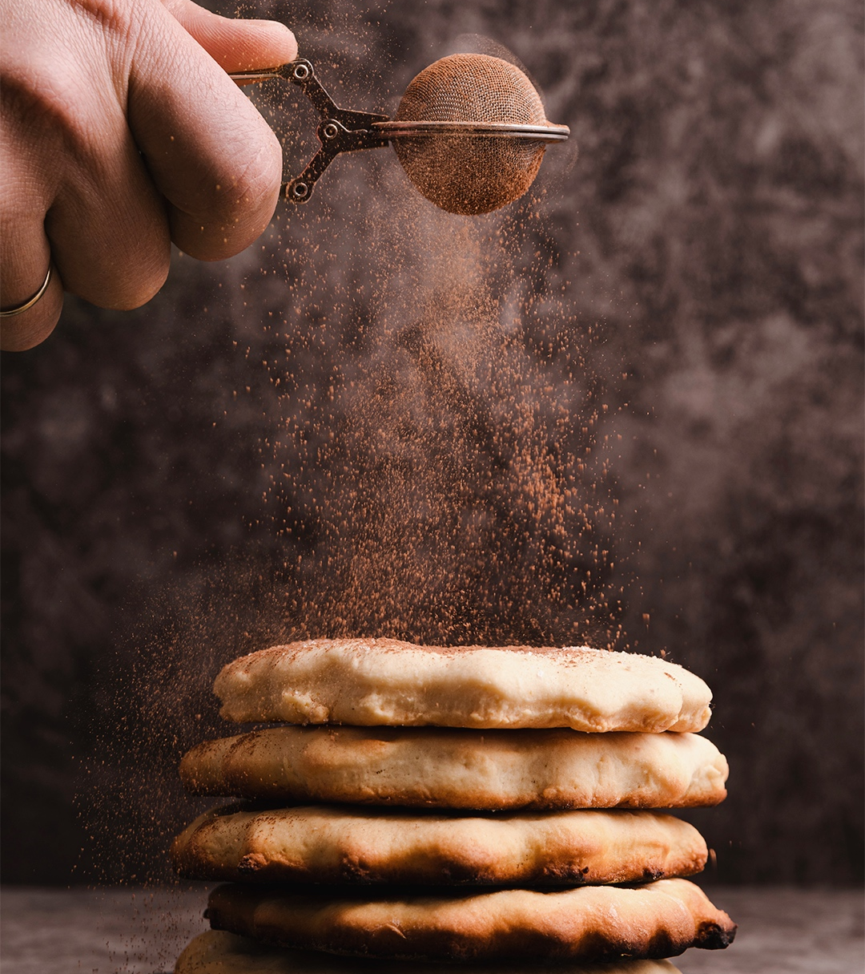
THANK YOU!
Do you have any questions?
ayala.jonalex@gmail.com
(718) 354-7609
linkedin.com/in/jonayala
Follow my code!
github.com/jon-ayala
Please keep this slide for attribution
Notes:
Thank you for viewing my presentation!
Should you have any questions, please feel free to contact me via email, and connect with me on LinkedIn. I’m looking forward to learning more about Gallery Media Group and the interview process!

